Slide 1

Applied Data Science with R
DSR301m

Slide 2
Course Objectives
Understand the basics of the R language
Understand how manipulate data with R programming language and implement fundamental programming tasks
Learn and apply foundational knowledge of the SQL &R languages, and how to access databases from Jupyter notebooks using SQL and R
Course Introduction

Slide 3
Course Objectives
Know how to wrangle data for data analysis, develop models, improve models, evaluate and tune the performance
Understand how to describe and build graphs using R packages. Implement various types of basic charts to visualize like bar charts, histograms, pie charts, scatter plots, line plots, and box plots
Implement a small data science project includes steps: data wrangling, data analysis, data visualization, model development, model evaluation, and reporting
Course Introduction

Slide 4
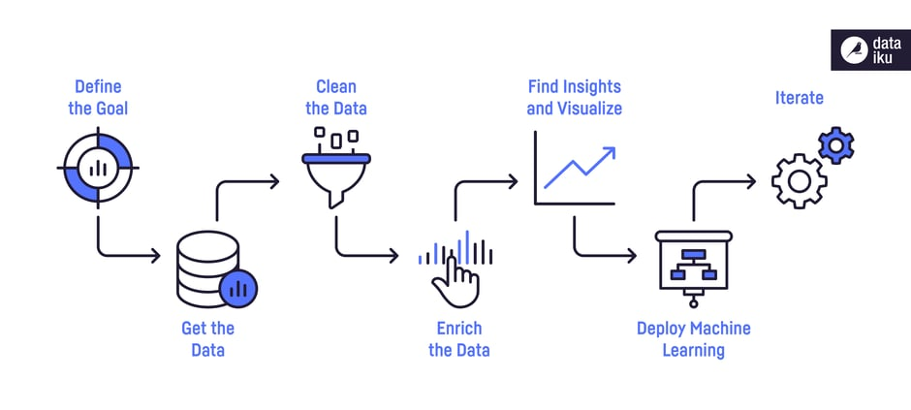

Course Objectives
Data Science Process
Course Introduction

Slide 5
Course Plan
Chapter 1: Introduction to R Programming for Data Science
Lab 1: Introduction to R Programming
Assignment
Chapter 2: SQL for Data Science with R
Lab 2: SQL with R
Quiz
Course Introduction

Slide 6
Course Plan
7. Chapter 3: Data Analysis with R
Lab 3: Data Analysis with R
Chapter 4: Data Visualization with R
Lab 4: Data Visualization with R
Grading: Assignment
Course Introduction

Slide 7
Materials/ References
Required References- Coursera courses
    Introduction to R Programming for Data Science
    SQL for Data Science with R
    Data Analysis with
    Data Visualization with R
Course Introduction

Slide 8
Learning Environments
RStudio IDE
Jupyter Notebooks
Course Introduction

Slide 9
Course Rules
How to conduct
  Prepare contents of the next session/ topic at home
  Following lessons in classrooms
  Completing chapter assessments in time and Quizzes
Communication
  Class/Interchange by FPTU CMS, Forum
  Discussing actively in your teams and in classrooms
Course Introduction

Slide 10
Evaluation Strategy
Must attend more than 80% of contact hours
(if not, not allow to take exam).
Evaluating
  02 Progress Test (Q) 20 %
  04 Labs 20 %
  Assignment 30%
  Final Exam (FE) 30 %
Total score
  20% (Qiz)+ 20%( lab) + 30% (Assignment) + 30% (FE)
Pass
  Total score ≥ 5 and Final Examination ≥ 4 (of 10)
  Every components > 0
Course Introduction

Slide 11
How to study
This course is complex knowledge (however, it’s attractive and exciting), so you need to keep tight grip on it
  Read
    On the books to get the general concept
    Reference, study, collection from anywhere else (internet, your classmates, forum …)
  Attend lectures
    Listens, understand, then make your own notes
    Give your explanation about some topic in lectures/ Ask questions
    Give some examples that are not existed in your book
    Practice all the exercises, demo to make your sense
Course Introduction

Slide 12
How to study
  After classes
    Discuss with your classmate in directly, on forum
    Do the lab, assignments to submit via LMS, and do more exercises
    Build your teams in yourselves to support together in studying
Course Introduction

Slide 13
How to exam/test
This course is required following rules, so you need to focus and practice your exercises and homework in try your best everyday
  Progress Tests
    No books
    No conversations
  Workshop/Assignment
    Not copy (copy code, contents, style)
Course Introduction

Slide 14
Academic policy
Cheating, plagiarism and breach of copyright are serious offenses under this Policy.
  Cheating
    Cheating during a test or exam is construed as talking, peeking at another student’s paper or any other clandestine method of transmitting information.
    Cheating during in making lab and assignment as copy source code, copy style, same meaning in progress, …
Course Introduction

Slide 15
Academic policy
Cheating, plagiarism and breach of copyright are serious offenses under this Policy.
  Plagiarism
    Plagiarism is using the work of others without citing it; that is, holding the work of others out as your own work.
  Breach of Copyright
    If you photocopy a textbook without the copyright holder's permission, you violate copyright law.
Course Introduction

Slide 16
Enjoy the Course
Be enthusiastic about the material because it is interesting, useful and an important part of your training.
Our job is to help you learn and enjoy the experience.
We will do our best but we need your help.
So, let’s all have fun together with DSR301m!
Course Introduction

Slide 17
Q & A
Course Introduction

